Slide 1
Dynamic Convolutional Neural Network for
Hyperparameter Optimization in Object Detection
IT416 Computer Vision
Sanket Babar 211IT015
Garvit Goyal 211IT021
Pranav Salunkhe 211IT059

Slide 2
Introduction
Traditional CNN architectures rely on fixed hyperparameters—such as kernel size, stride, and padding—throughout the network's layers.
Different types of images may benefit from different configurations in convolutional and pooling layers to better capture features, improve accuracy, and reduce unnecessary computations.
Squeeze-and-Excitation (SE) blocks for channel-wise attention, enhancing the network’s ability to capture important features by adaptively recalibrating channel weights.

Slide 3
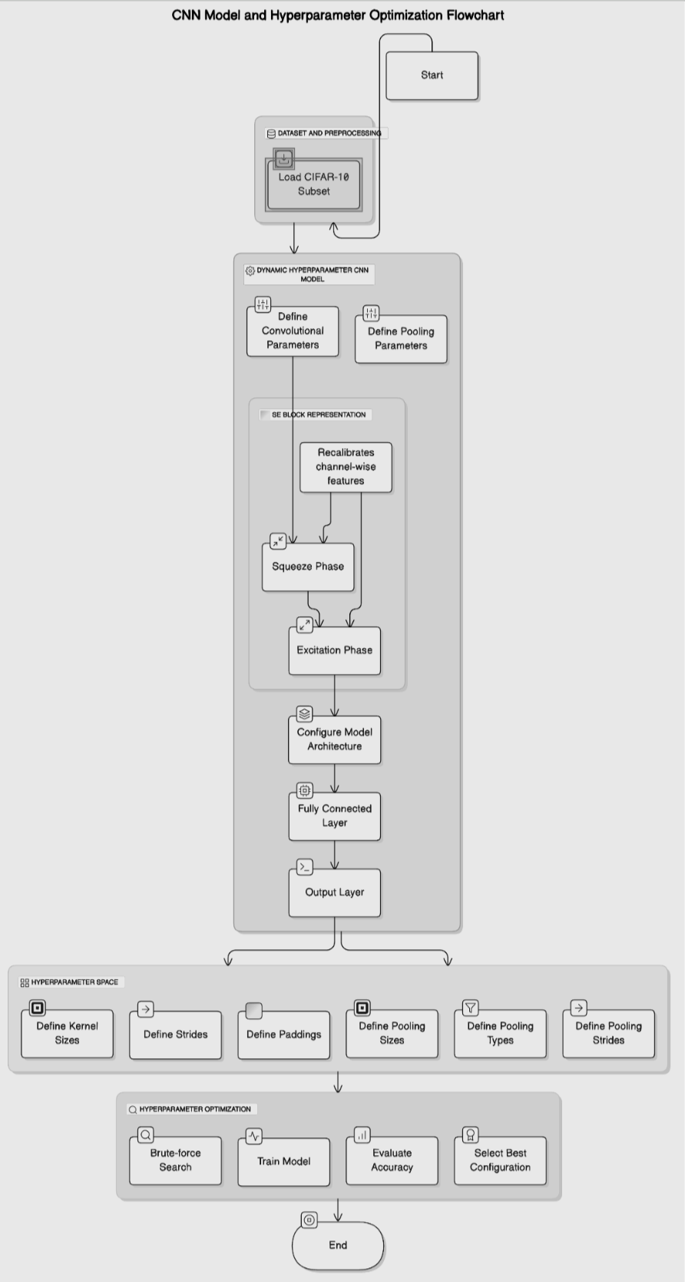
Architecture
2 Convolutional Layers
SE Block (Attention)
2 Pooling Layers
2 Fully Connected Layers
Dynamic Flattening Calculation

Slide 4
Dataset Preparation
The dataset used in this study is CIFAR-10, a widely recognized benchmark dataset for image classification tasks. CIFAR-10 consists of 60,000 color images, each sized 32x32 pixels with three color channels (RGB).
The dataset is divided into 10 mutually exclusive classes, including airplane, automobile, bird, cat, deer, dog, frog, horse, ship, and truck. Each class contains 6,000 images for a balanced distribution across categories.
The a subset of random 10,000 images is used for training, ensuring that model trained on CIFAR-10 can be evaluated objectively.

Slide 5
Methodology
• Convolutional Layers: Two convolutional layers are de- fined: conv1: A dynamically configured layer based on the hyperparameters specified for kernel size, stride, and padding. conv2: A fixed layer with a kernel size of 3, stride of 1, and padding of 1.
• SE Block (Attention): After conv1, an SE (Squeeze-and-Excitation) block is used for adaptive attention, designed to recalibrate feature maps by: Squeeze Phase: Applies global average pooling to produce a channel-wise descriptor. Excitation Phase: Uses two fully connected layers to generate a channel-wise scaling factor (sigmoid out- put) applied to the feature maps, enhancing important features.

Slide 6
Methodology
• Pooling Layers: Two pooling layers are applied to down-sample the feature maps: pool1: Configured based on user-defined parameters, such as type (max or average), kernel size, and stride. pool2: A fixed max-pooling layer with kernel size 2 and stride 2.

Slide 7
Methodology
• Fully Connected Layers: Two fully connected layers (FC1 and FC2) are used at the output: FC1: Connects the flattened convolutional output to a hidden layer with 128 neurons. FC2: Outputs a 10-dimensional vector corresponding to the CIFAR-10 classes.
• Dynamic Flattening Calculation:
A helper function, get flattened size(), computes the flattened feature map size dynamically by passing a dummy input through the model. This is essential to accommodate varying input dimensions resulting from different convolution and pooling configurations.

Slide 8
Methodology
Hyperparameter search:
A brute-force search over possible configurations for the CNN’s convolutional and pooling layers. This involves iterating through all combinations of kernel sizes, strides, padding, and pooling parameters. For each configuration, the evaluate configuration function is used to measure accuracy. The best configuration is then selected.

Slide 9
Methodology
Evaluation Function:
Initialize the CNN model with the specified convolution and pooling parameters. • Train the model for 8 epochs using the Adam optimizer with a learning rate of 0.001 and cross-entropy loss. • Evaluation of the model’s performance on the training subset by calculating the prediction accuracy, which serves as the evaluation metric for each configuration.

Slide 10
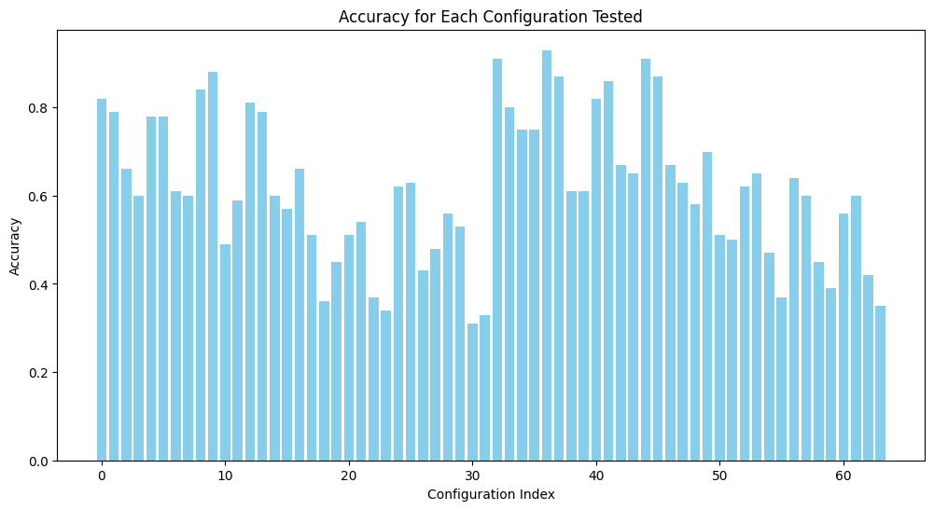
Results

Slide 11
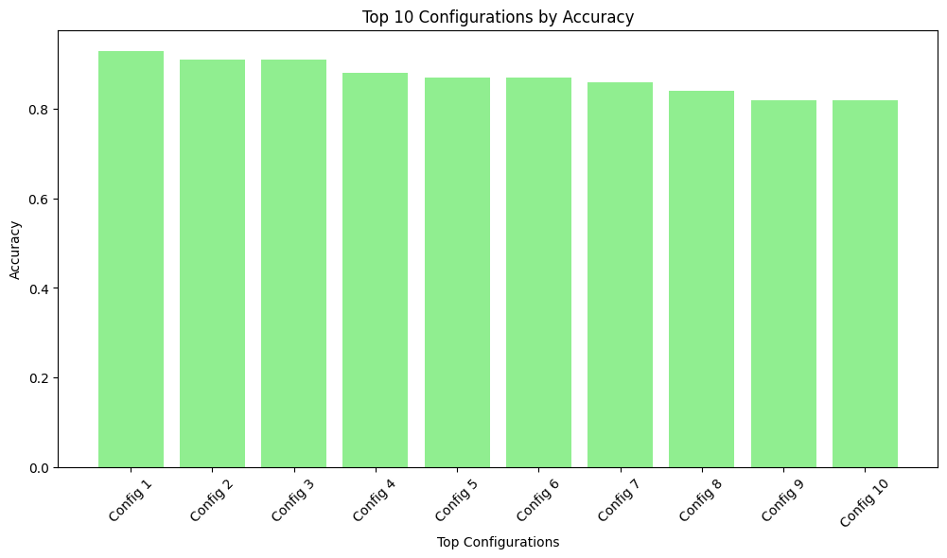
Results
Accuracy: 0.9800
Params: {'kernel_size': 5, 'stride': 1, 'padding': 1} | {'size': 2, 'stride': 1, 'type': 'max'}
Accuracy: 0.9800
Params: {'kernel_size': 3, 'stride': 1, 'padding': 0} | {'size': 2, 'stride': 1, 'type': 'avg'}
Accuracy: 0.9800
Params: {'kernel_size': 5, 'stride': 1, 'padding': 0} | {'size': 3, 'stride': 1, 'type': 'max'}
Accuracy: 0.9600
Params: {'kernel_size': 5, 'stride': 1, 'padding': 1} | {'size': 3, 'stride': 1, 'type': 'avg'}
Accuracy: 0.9500
Params: {'kernel_size': 3, 'stride': 1, 'padding': 1} | {'size': 2, 'stride': 1, 'type': 'avg'}

Slide 12
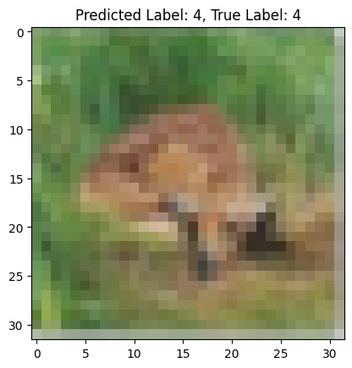
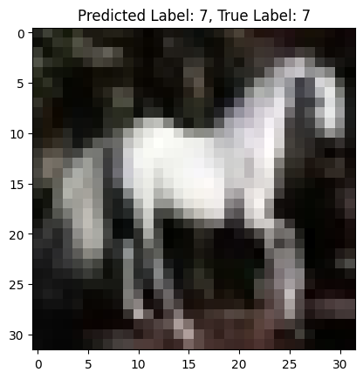
Results
4: Deer, 7: Horse

Slide 13
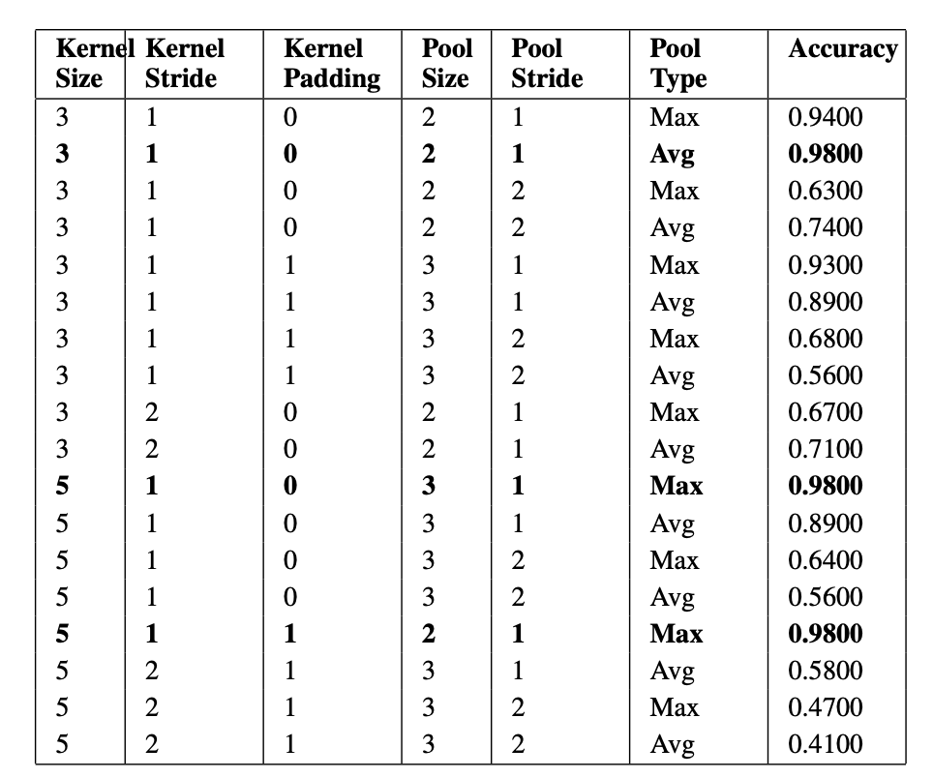

Results
Summary of model accuracies with different kernel and pooling parameters.
Best ones are bold.
Comparison with other state-of-the-art models:

Slide 14
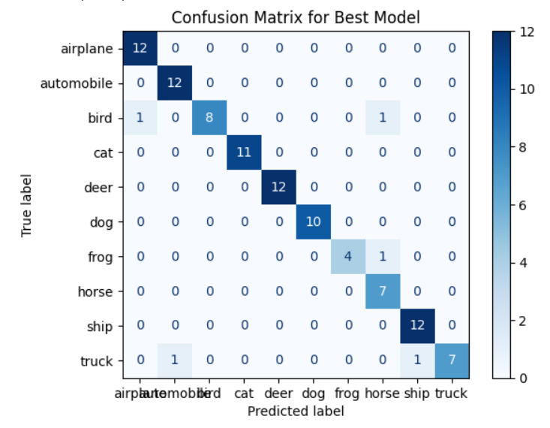
Evaluation Metric
Final Evaluation Metrics for the Best Model
Accuracy: 0.9500
Precision (Macro): 0.9547
Recall (Macro): 0.9378
F1 Score (Macro): 0.9408

Slide 15
Conclusion and Future Work
Explored the impact of hyperparameter tuning on the performance of a Convolutional Neural Network (CNN)
SE block is lightweight compared to the depth of the network and introduces only a small number of additional parameters. Its effectiveness-to-cost ratio is high.
Demonstrated the on-par performance of our model with other state-of-the-art models.
As future work, application of transfer learning can be explored to view how the model adapts across different datasets.

